Slide 1
Nuclear Fuel Performance
NE-533
Spring 2025

Slide 2
Last Time
We derived two analytical solutions for the stress in a pressurized cylinder
Thin walled cylinder
Thick walled cylinder
Thermal expansion is a strain that doesn’t inherently cause stress
Thermal expansion can cause stress when there is a temperature gradient
We have analytical equations for thermal stresses
in the cladding
in the fuel

Slide 3
Paper Project
Assigned papers uploaded to moodle with your name as a prefix
This will be a critical review of the paper, similar to what we do for QE2, but much shorter
15 minute presentation that summarizes what was done in the paper, provides context on why it was done, and reviews what could or should have been done, or could be done next
All presentations will be submitted via moodle, due by end of the day on Mar. 20
Presentations will take place in-class on Mar. 21 and Mar. 26
If you have a specific paper that you would like to review and applies to this topic field, present it to me and I will consider it

Slide 4
Material Property Evolution

Slide 5
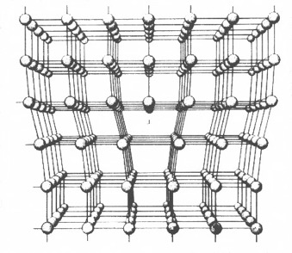
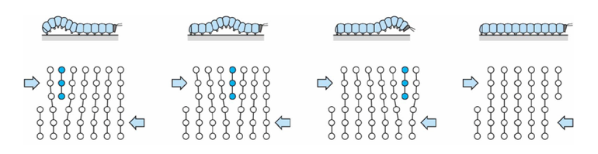
Dislocations are imperfections associated with a line of lattice sites (1D defect)
In a dislocation, an extra half plane of atoms is inserted into the lattice
When it moves, only a small number of bonds are broken at a time
Dislocation motion controls the plastic (permanent) deformation of crystalline materials

Slide 6
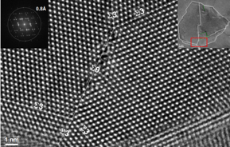
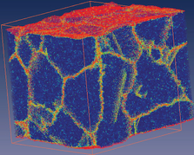
Grain boundaries
Materials are typically composed of various regions where the crystal lattice is oriented differently. These regions are called grains
When two grains meet, there is a plane of atoms that do not follow the crystal lattice called a grain boundary
Most crystalline materials are polycrystalline, not single crystal
High-res transmission eleectron microscopy can also show individual atoms (palladium)
www.knmf.kit.edu/TEM.php
Atomistic simulation of grain boundaries in 3D

Slide 7
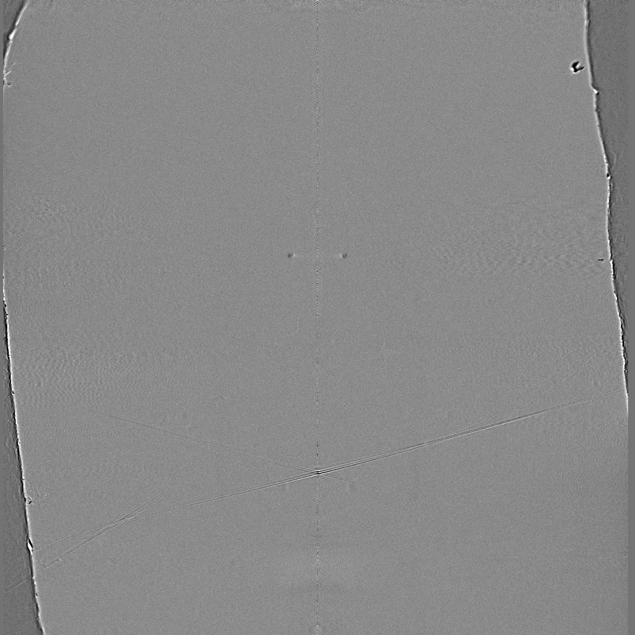
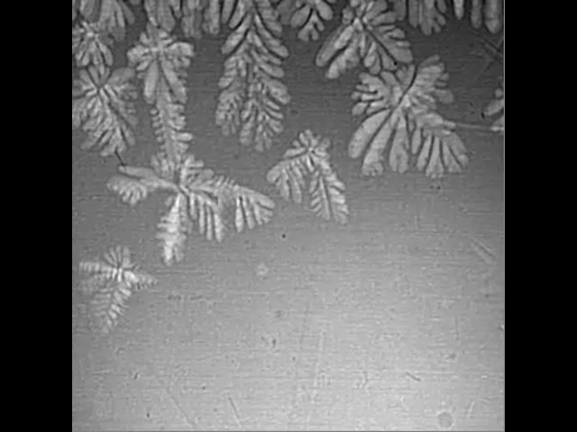
Metals are often cast, and polycrystals naturally form during casting

Slide 8
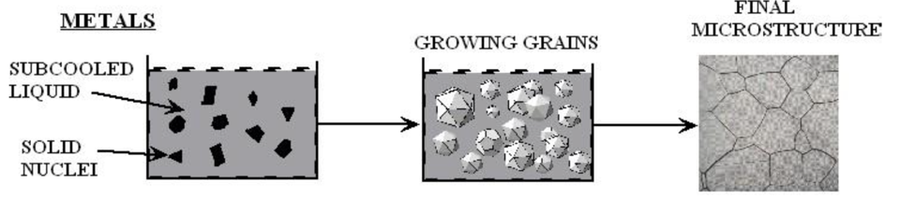
Polycrystals naturally form during casting
Solidification begins in different regions of the melt, each with a different orientation
Once the different regions meet, grain boundaries form between them

Slide 9
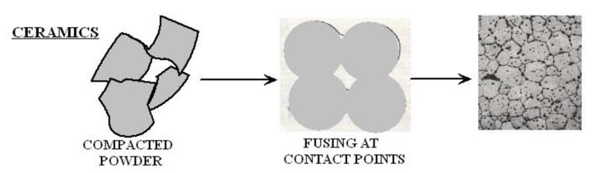
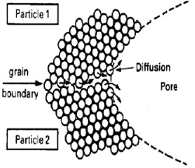
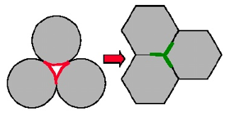
Ceramic sintering
Ceramics are typically sintered, and polycrystals also naturally form from sintering
In sintering, powders are compacted at high temperature
The particles are each oriented differently, and as they fuse, grain boundaries form
The differences between the grain orientations result in the grain boundary

Slide 10
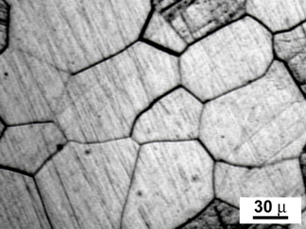
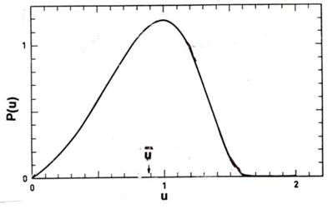
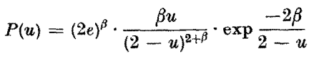
Distribution of grain sizes
In a polycrystal, there is also a distribution of grain sizes
Therefore, we commonly refer to the grain size distribution and the average grain size
The Hillert distribution is an analytical distribution for grain size
Real materials often vary from this behavior

Slide 11
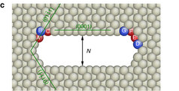
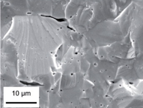
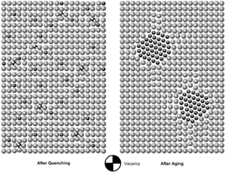
3D Defects
When point defects cluster, they form three dimensional defects
The energy of a point defects is reduced when several point defects cluster together
Larger clusters of vacancies are called voids
Clusters of impurity atoms are called precipitates

Slide 12
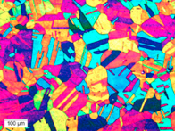
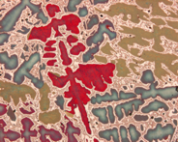
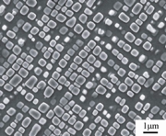

Microstructure
Material microstructure is the structure observable with 25x magnification
The microstructure includes grain structure, secondary phases, porosity, and more
The microstructure can strongly influence physical properties such as strength, toughness, ductility, hardness, corrosion resistance, high/low temperature behavior or wear resistance.
These properties in turn govern the application of these materials in industrial practice
Annealed Stainless Steel
Cast Bronze
Sintered UO2
Co-Al-W Superalloy
Friction stir welded stainless steel

Slide 13
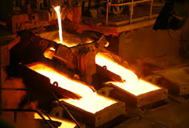
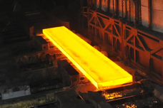
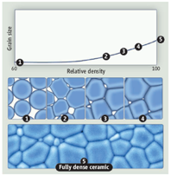
Material processing
The processes we use to make a material have a huge impact on its microstructure and properties
Casting – manufacturing process in which a liquid material is poured into a mold and then allowed to solidify
Can be used to make complex shapes
The solidified microstructure typically has properties that are far from ideal
Sintering – Forming a solid from a powder using heat and/or pressure without melting the material
Applicable to metals and ceramics
Difficult to obtain a material that is fully dense
Used to make fuel pellets
Post-fabrication processing
heat treatment
working

Slide 14
Material processing
Heat treatment: heating or cooling a material to extreme temperatures to get desired microstructure and properties
Used to control the rate of microstructure change, including diffusion, grain growth, or phase change
Annealing
heat and hold the material, which allows for any defects in the material to repair themselves
The metal is then allowed to cool back to room temperature at a slow pace to produce a more ductile crystalline structure
Quenching
heated to a temperature that transforms its internal structure, held at that temperature, then rapidly cooled
The quick cooling process locks in the high T structure, or forces phase transformation without the ability to relax stresses

Slide 15
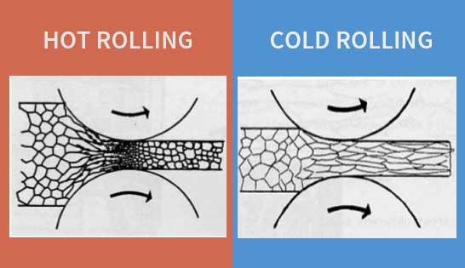
Material processing
Working: metalworking process that plastically deforms the alloy
Cold working occurs below the recrystallization temperature, hot working occurs above
By plastically deforming the material, we are increasing the number of dislocations and dislocation barriers, increasing the yield strength
Main types of working processes:
Squeezing (rolling/extrusion/drawing)
Bending (shaping)
Shearing (slitting)

Slide 16
Summary
Gap size changes due to thermal expansion, changing temperature profile
Often have displacements instead of strains, and can solve for stress via displacements
Fuel and pellet conditions change with time due to microstructure evolution
Atoms in the fuel and cladding materials are arranged in a crystal lattice
The crystal lattice is never perfect; it has defects
Point defects, dislocations, grain boundaries, voids and precipitates
All materials have defects, radiation damage causes many more defects
Microstructure can be tailored through processing, during fabrication or post-fabrication

Slide 17
mechanistic modeling

Slide 18
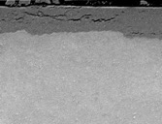
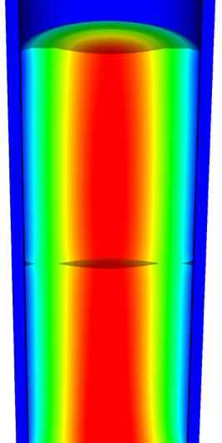
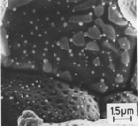
Microstructure-based fuel performance modeling
Structure/property relationships connect the microstructure variables to the property values
Operating Conditions
Neutron flux
Coolant T&P
Variables
Temperature
Displacement
Stoichiometry
Cladding
Property values
Microstructure evolution models
Microstructure evolution models
Fuel Property values
Elasticity tensor
Elasticity tensor
Grain growth
Grain growth
Cladding
Microstructure variables
Average grain size
Dislocation density
H concentration
Hydride fraction
Point defect concentrations
Loop density
2nd phase particle fraction
Fuel
Microstructure variables
Average grain size
Dislocation density
U defect concentrations
Pu concentration
Fission product precipitate fractions
Dissolved fission products
Fission gas bubble fraction
Grain boundary fission gas bubble coverage
Crack parameter
Plasticity
Plasticity
Thermal conductivity
Yield stress
Defect prod. & transport
Defect prod. & transport
Fracture stress
Thermal conductivity
Hydrogen transport
Fission gas behavior
Melting temperature
Failure criteria
Loop evolution
Densification
Diffusion constants
Dimensional change
Gap variable
Gap fission gas concentration
Fracture
Dimensional change

Slide 19

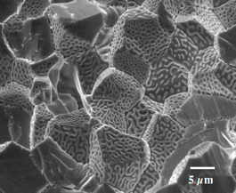
Example: fission gas behavior in the fuel
Take into account a finite set of variables to describe the state of the material
Utilize a mechanistic model of fission gas behavior to predict the evolution of the microstructure
Utilize this updated microstructure to inform a number of structure/property relationships
Variables
Temperature
Displacement
Stoichiometry
Elasticity tensor
Thermal conductivity
Model of fission gas behavior
Structure/property relationships
Fracture stress
Dissolved fission products
Fission gas bubble fraction
Grain boundary fission gas bubble coverage
Gap fission gas concentration
Dimensional change
Gap conductance
Gap pressure

Slide 20
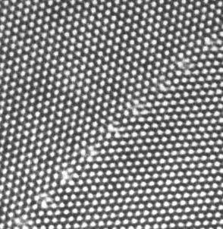
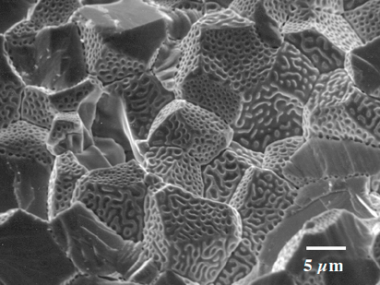
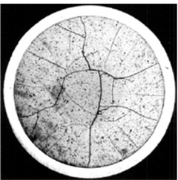
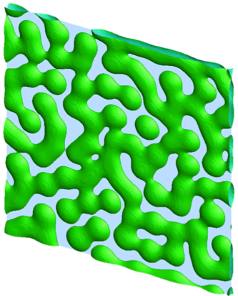
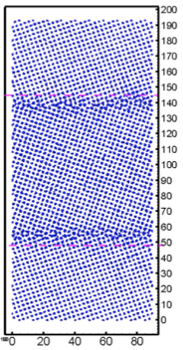
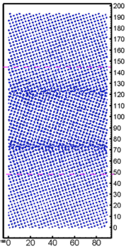
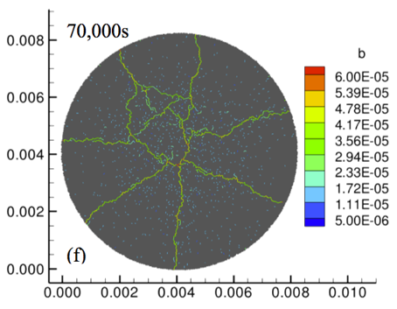
Multiscale separate effects experiments and simulations inform the development of the models
nm
μm
mm

Slide 21
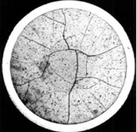
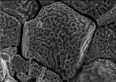
Microstructure-based models
Can provide a structure/property relationship to replace the existing burnup dependent model
For example, thermal conductivity, taking into account microstructural features and their evolution
Grain boundary and bubbles
Intragranular porosity
Precipitated fission products
κ_{pr}
Bulk conductivity
Vacancies and interstitials
Fission gas

Slide 22
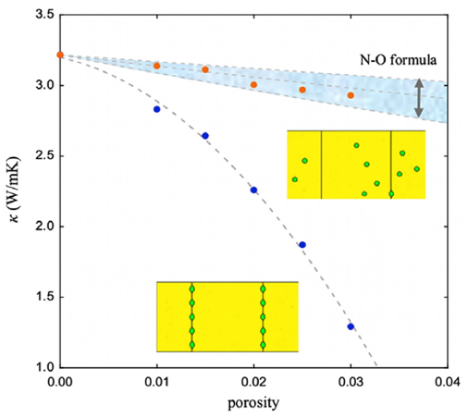
Parametrizing the mechanistic model
We employ multiscale modeling and simulation to determine the various parameters for the model
MD simulations conducted at LANL have been used to determine the coefficients for various point defects
MD simulations have shown that phonon scattering must be accounted for to accurately represent small bubbles
Mesoscale simulations have shown that GrB bubbles have a larger impact on the thermal conductivity
Maxwell-Eucken (no phonon scattering)

Slide 23
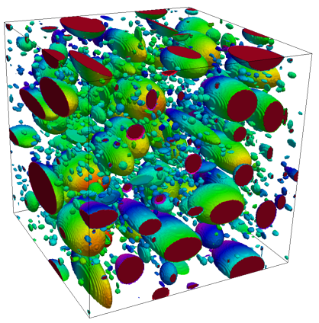
Parametrizing the mechanistic model
A thermal resistor model is created to describe the impact of GrB bubbles on the thermal conductivity
MARMOT simulations are currently being used to inform the development of the precipitate multiplier

Slide 24
Parametrizing the mechanistic model
Each term in the expression must be coupled to a corresponding state variable
The full model calculates the thermal conductivity as a function of:
Temperature
Point defect concentrations
Intragranular bubble density and average radius
Fractional coverage of bubbles on GBs and average radius
Precipitate volume fractions and average sizes
Currently effects of precipitate fission products and individual point defects are neglected in the model, as they are not tracked or predicted in BISON

Slide 25
Comparing with experiments…
The model under-predicts the temperature in most cases, but not all
Thus, the model is neglecting some resistive effects from the microstructure
Generally performs as well, and in some cases better, than the burnup based model
RISO-3 AN3
RISO-3 AN4
RISO II-3
US PWR TSQ0002

Slide 26
UZr Fuel Performance Modeling
Development of a quantitative phase-field model of macroscale constituent redistribution in the U-Zr system, where model parameters were optimized, and the model validated against an independent data set
Calculation of surface tension based on molecular dynamics, which is used in the BISON gaseous metallic fuel swelling model

Slide 27
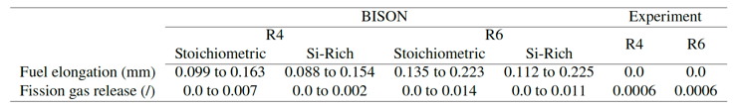
U3Si2 Fuel Performance Modeling
Point Defect Diffusion, Fission gas swelling, thermal and irradiation creep

Slide 28
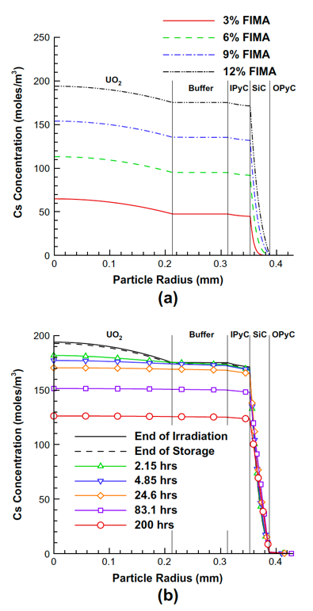
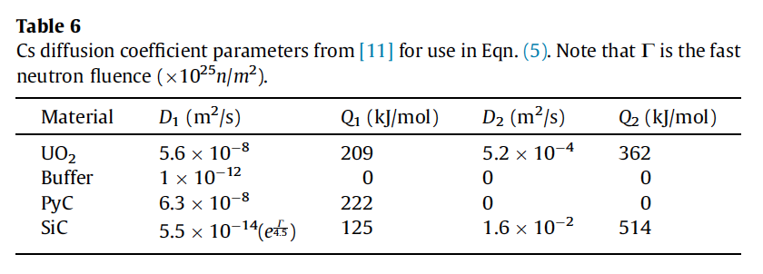
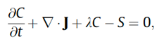
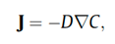
TRISO Particle Fuel Performance Modeling
TRISO particle modeling is still under development from a mechanistic model standpoint
Imperfect data for many critical fission products through different layers
Data typically for UO2 only, not for UC or UCO fuel kernels

Slide 29
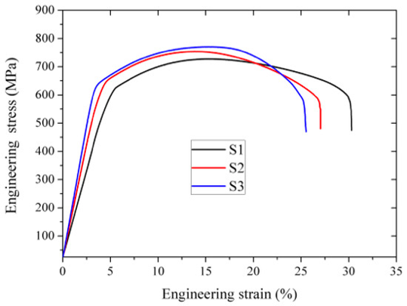
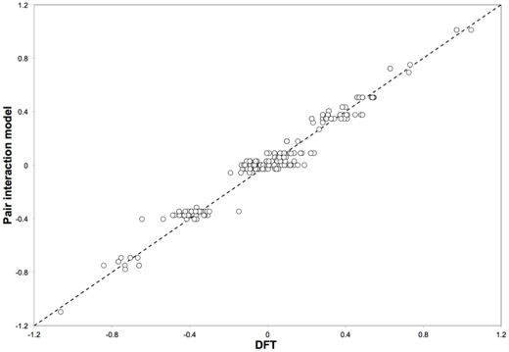
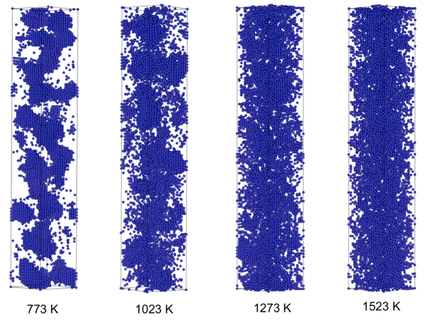
FeCrAl
Evolution of compositional randomness (precipitation) will affect the mechanical properties of FeCrAl
Kinetic Monte Carlo simulations modeled the precipitation of alpha’ phase from bcc Fe-Cr alloys under thermal aging at various temperatures
Fe-Al alloys do not show any phase separation
Can determine critical temperatures for precipitation and the resulting microstructures to investigate potential hardening

Slide 30
Summary
Researchers are working to develop materials models for the fuel and cladding that are mechanistic rather than empirical and that are based on the evolution of the microstructure rather than the burnup

